Slide 1

HoneyPot
Security Tech Solutions, LLC

Slide 2



Intro to HoneyPot
What is a honeypot?
A cyber trap or decoy designed to look like a legitimate part of a system, network, or other digital environment
How do they operate?
Research vs Production
Use security vulnerabilities to lure in attackers
Benefits of using a honeypot
Detection of malicious activity
Diversion of malicious traffic
Data collection

Slide 3

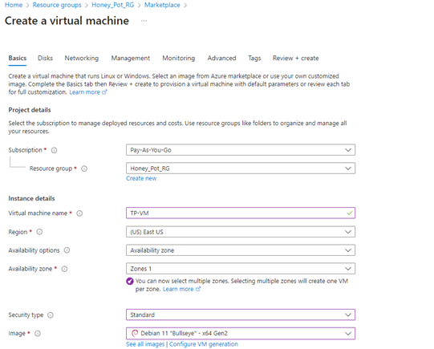
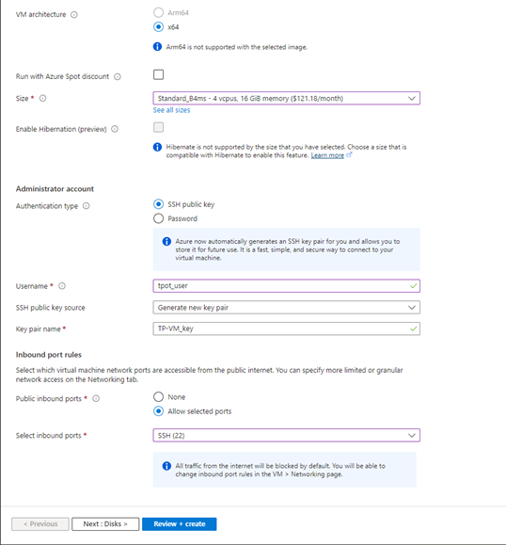
Deployment to Azure

Slide 4
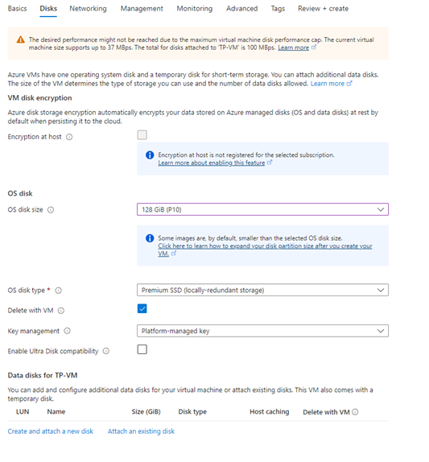
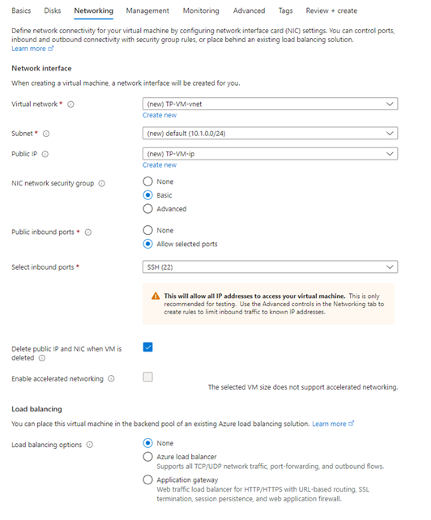
Disk and Networking

Slide 5
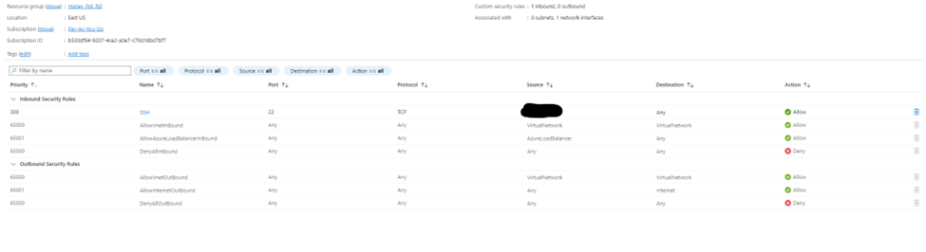

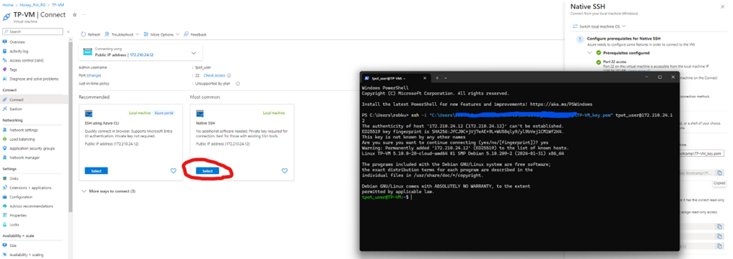
Net_Sec Group and Preparing for Install

Slide 6

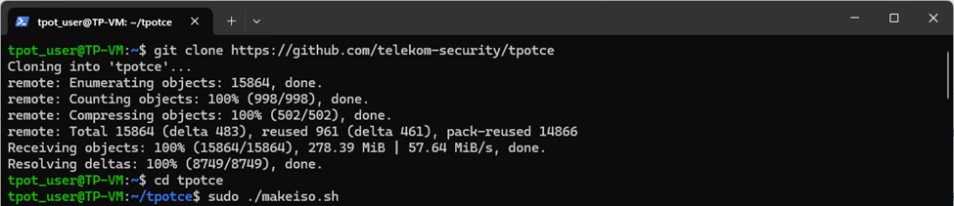

Physical Network install

Slide 7

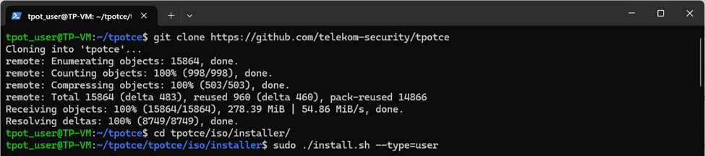

User Install Method
(If you have Debian already Installed)

Slide 8
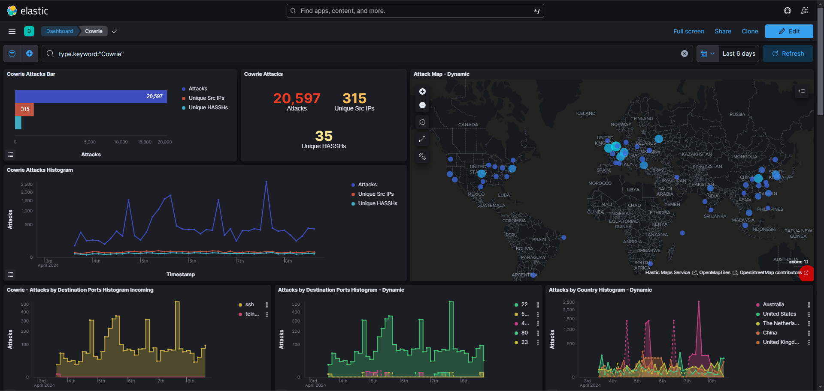
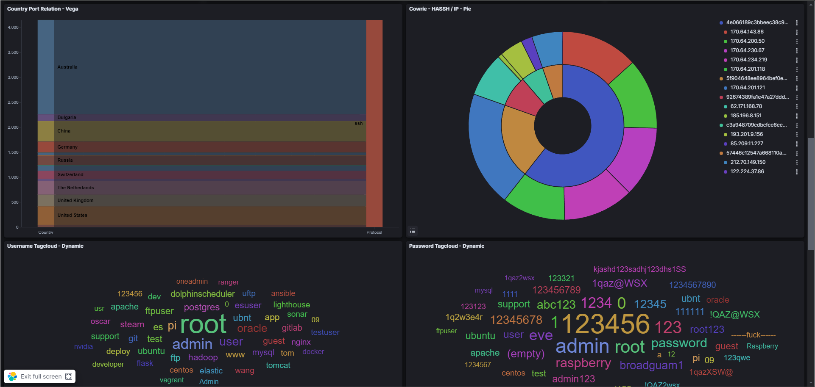
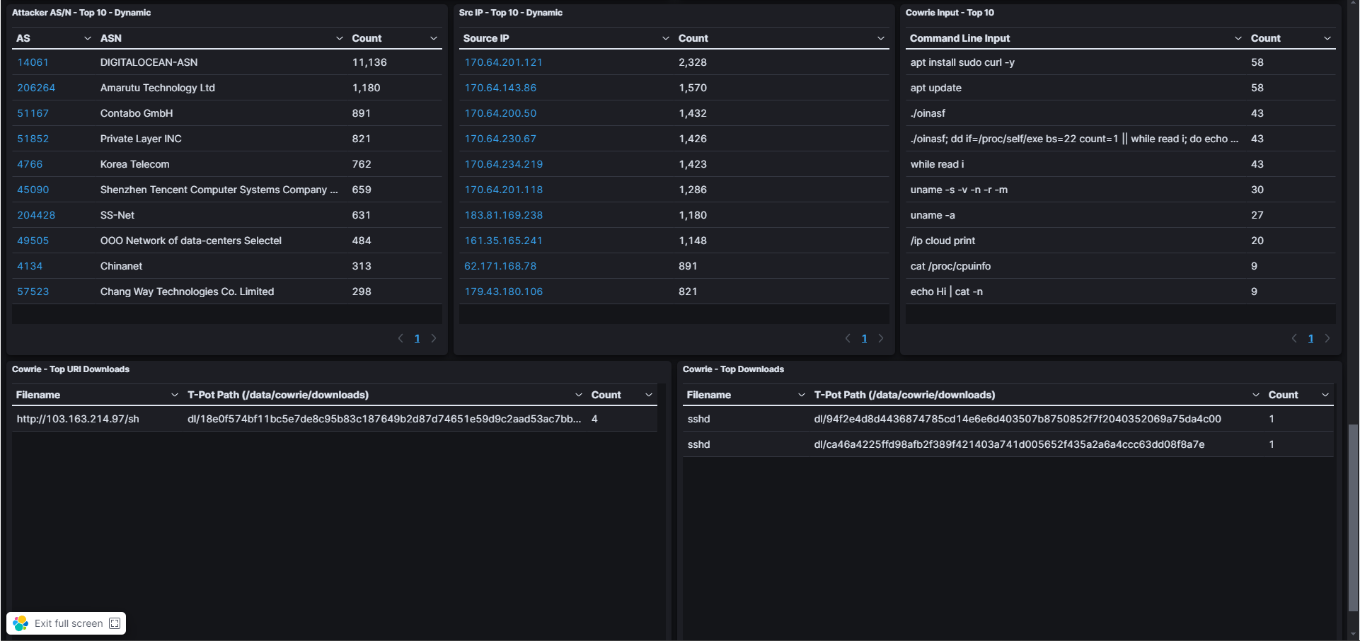
Elasticvue/Kibana

Slide 9

Honeypot Demonstration: Cowrie
Vulnerability: Ports 22 and 23
Mike Staples

Slide 10
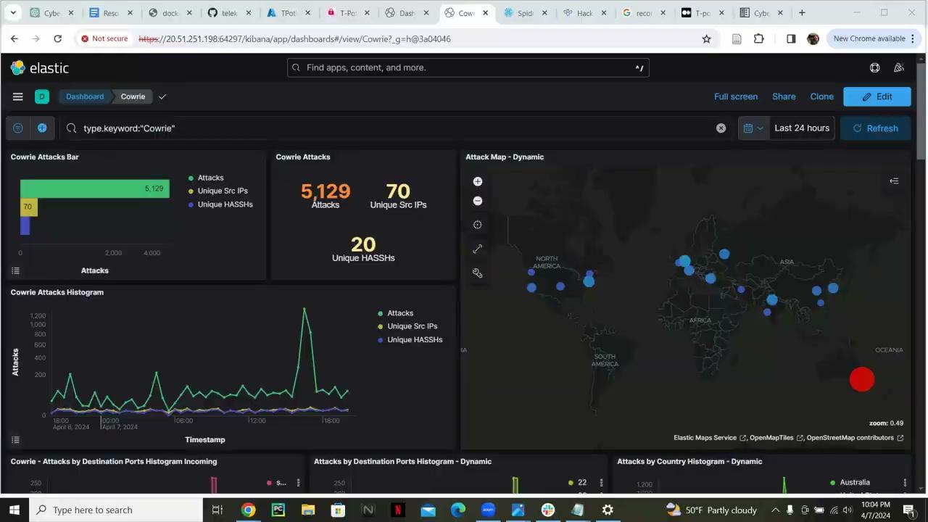

Slide 11

Honeypot Demonstration: Tanner
Vulnerability: HTTP
Nathan Almeida

Slide 12


Slide 13

Legal/Ethical Implications
Entrapment
Despite the controversy, Honeypots are not a form of entrapment
Honeypots don’t induce anyone
Privacy
Federal Wiretap Act
Exemption under Service Provider Protection
Liability
Liability implies you could be sued if your honeypot is used to harm others.
Civil issue

Slide 14
Resources
T-Pot/tpotce
https://github.com/telekom-security/tpotce?tab=readme-ov-file#ssh-and-cockpit

